Slide 1
Frequent Itemset Mining

Slide 2


Slide 3
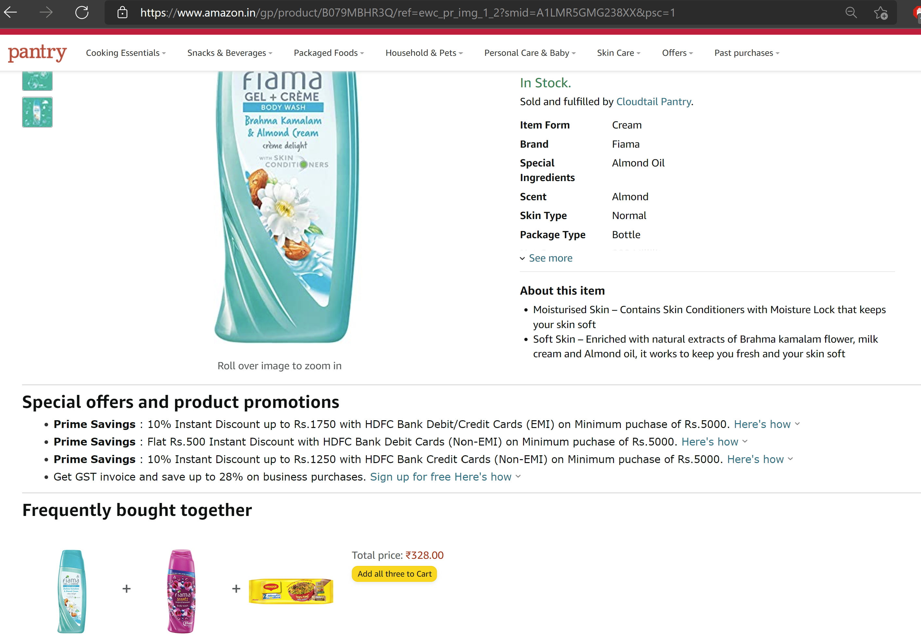
Application

Slide 4
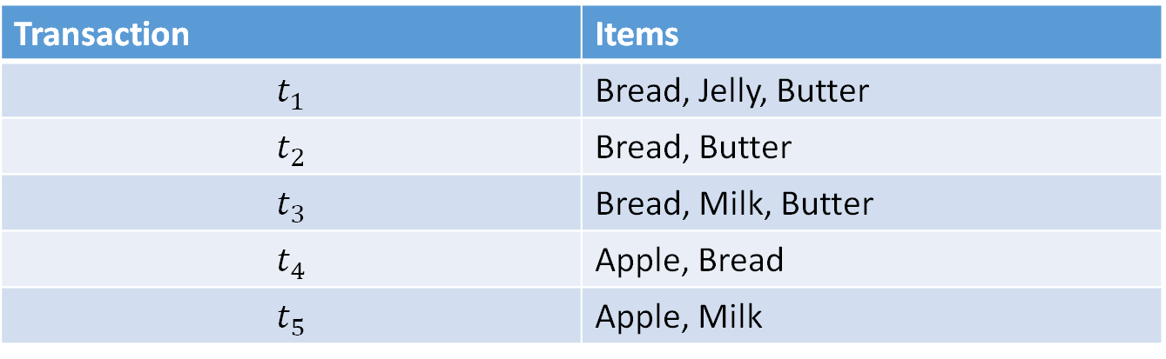
Association Rules Example
Transaction | Items
$$t_{1}$$ | Bread, Jelly, Butter
$$t_{2}$$ | Bread, Butter
$$t_{3}$$ | Bread, Milk, Butter
$$t_{4}$$ | Apple, Bread
$$t_{5}$$ | Apple, Milk
I = {Apple, Bread, Jelly, Milk, Butter}
Bread => Butter happens pretty frequently

Slide 5
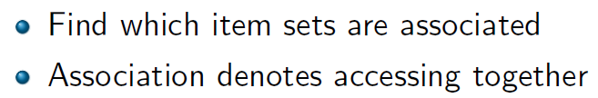
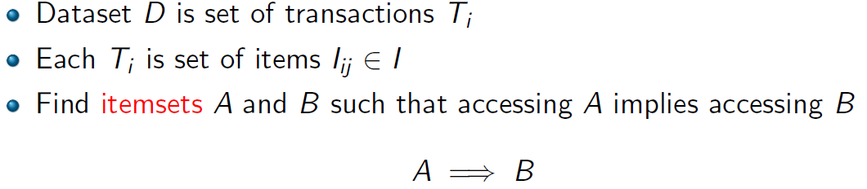
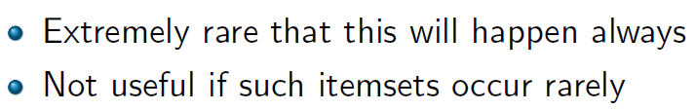
Association rule mining

Slide 6
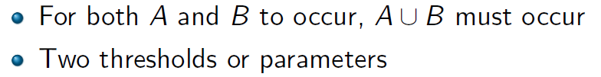
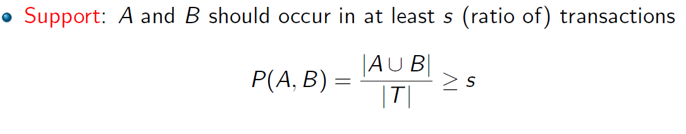
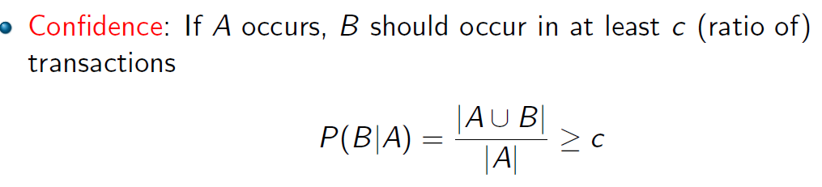
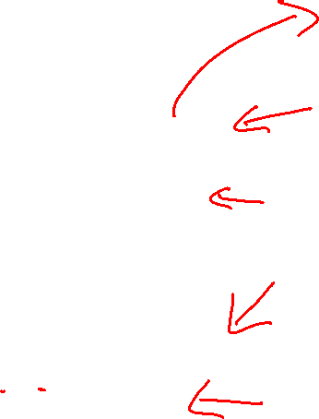
Parameters of an Association Rule

Slide 7
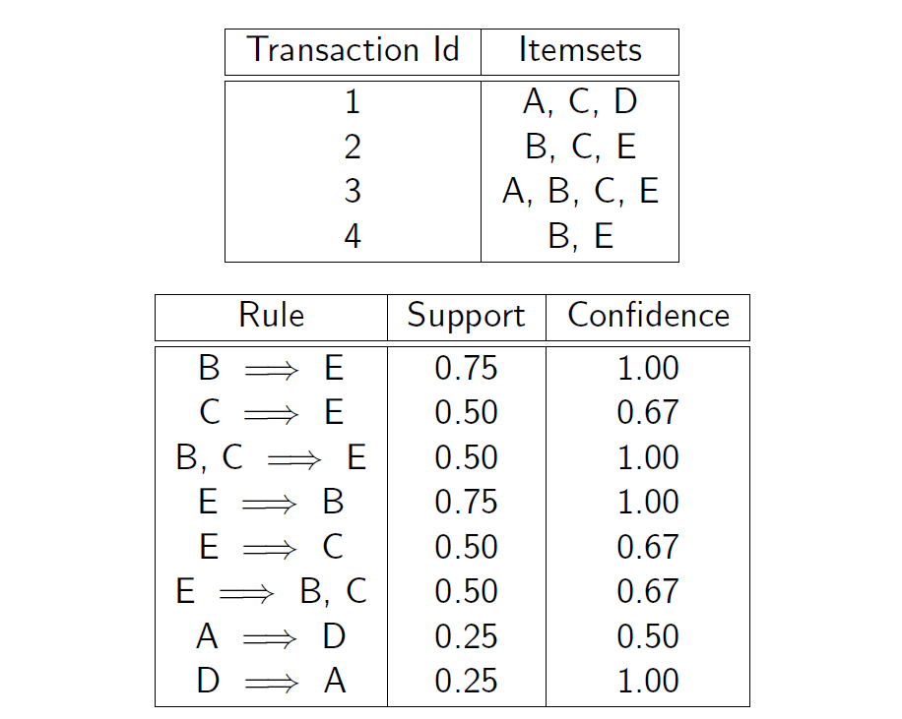

Slide 8
Mining Association Rules
Given a support threshold s and confidence threshold c
Mine all frequent itemsets, i.e., support of the itemset is above s
For association rules from frequent itemsets, i.e., each rule has confidence above c

Slide 9
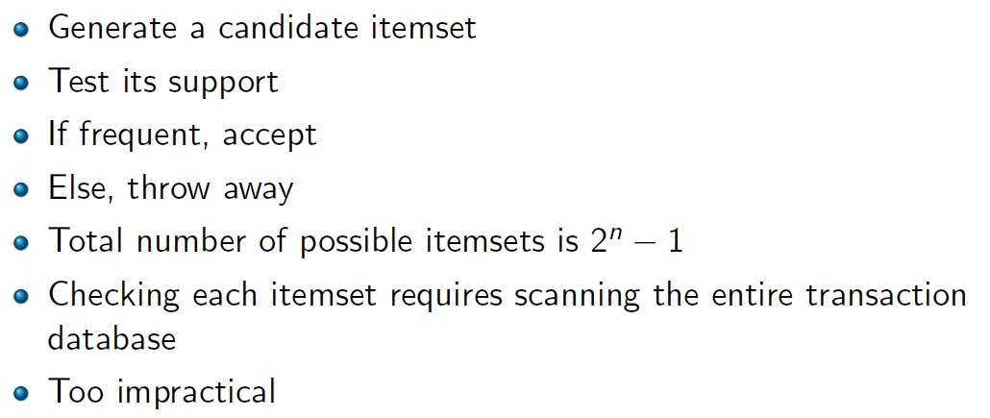
How difficult is the problem?
What is the naïve approach?

Slide 10
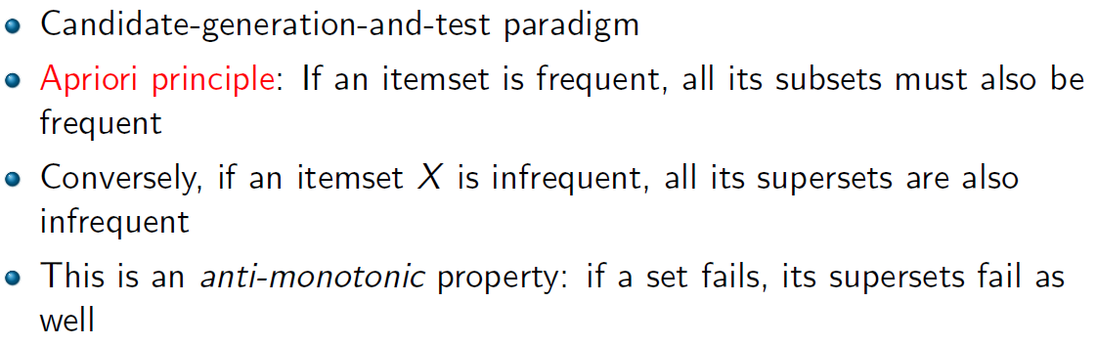
Apriori Principle

Slide 11
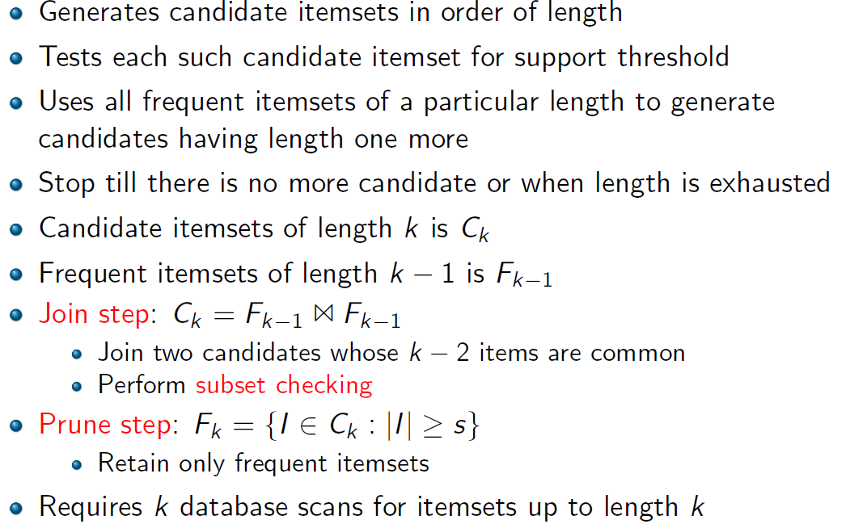
Apriori Algorithm

Slide 12
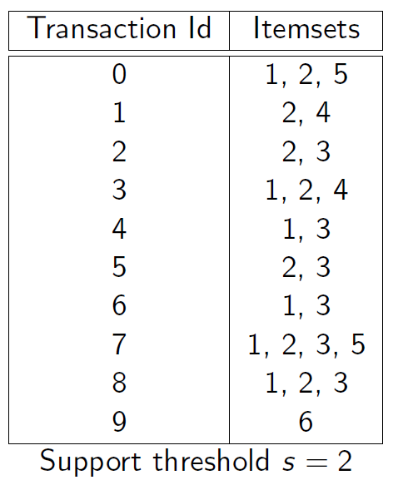

Slide 13
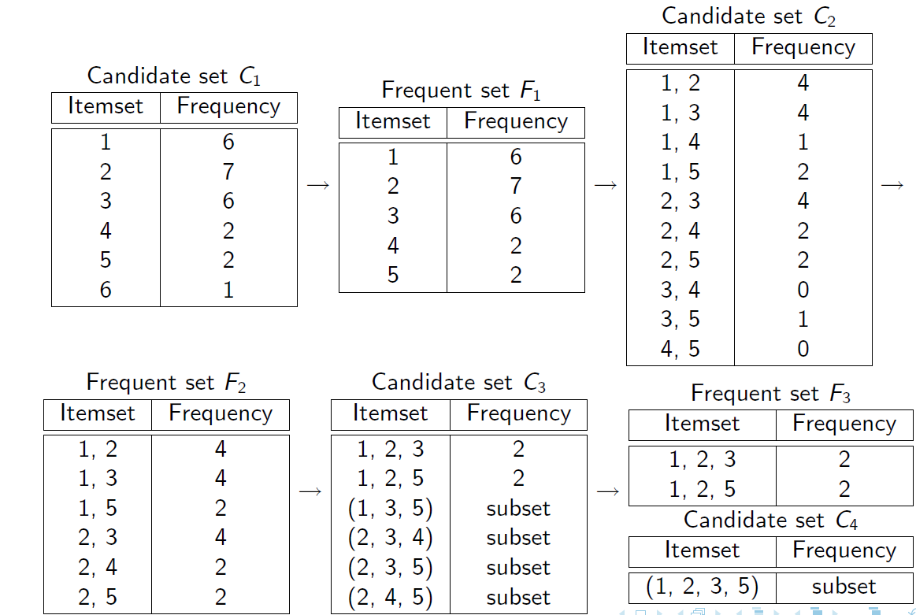

Slide 14
Do we need to count support of all generated candidates?
F₃ = {{1, 2, 3}, {1, 2, 4}, {1, 3, 4},
{1, 3, 5}, {2, 3, 4}}
After join
C₄ = {{1, 2, 3, 4}, {1, 3, 4, 5}, {1,2,3,5}}
After pruning:
C₄ = {{1, 2, 3, 4}}
because {1, 4, 5} and {1, 2, 5 } are not in F₃ ({1, 3, 4, 5} and {1, 2, 3, 5} are removed)

Slide 15
Ordering Itemsets
The items in I are sorted in lexicographic order (which is a total order).
The order is used throughout the algorithm in each itemset.
{w[1], w[2], …, w[k]} represents a k-itemset w consisting of items w[1], w[2], …, w[k], where w[1] < w[2] < … < w[k] according to the total order.

Slide 16
Details: the algorithm
Algorithm Apriori(T)
C₁ ← init-pass(T);
F₁ ← {f | f ∈ C₁, f.count/n ≥ minsup}; // n: no. of transactions in T
for (k = 2; F_{k-1} ≠ ∅; k++) do
C_{k} ← candidate-gen(F_{k-1});
for each transaction t ∈ T do
for each candidate c ∈ C_{k} do
if c is contained in t then
c.count++;
end
end
F_{k} ← {c ∈ C_{k} | c.count/n ≥ minsup}
end
return F ← _{k} F_{k};

Slide 17
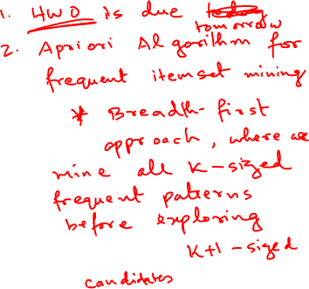
Candidate-gen function
Function candidate-gen(F_{k-1})
C_{k} ← ∅;
forall f₁, f₂ ∈ F_{k-1}
with f₁ = {i₁, … , i_{k-2}, i_{k-1}}
and f₂ = {i₁, … , i_{k-2}, i’_{k-1}}
and i_{k-1} < i’_{k-1} do
c ← {i₁, …, i_{k-1}, i’_{k-1}}; // join f₁ and f₂
C_{k} ← C_{k} ∪ {c};
for each (k-1)-subset s of c do
if (s ∉ F_{k-1}) then
delete c from C_{k}; // prune
end
end
return C_{k};

Slide 18
Why k database scans?
Read each transaction from disk and check frequency of all candidates of size 1
Repeat for candidates of size 2…till size k
Why is the number of database scans important?
~1000 times slower than main-memory scans.

Slide 19

Step 2: Generating rules from frequent itemsets
Frequent itemsets ≠ association rules
One more step is needed to generate association rules
For each frequent itemset X,
For each proper nonempty subset A of X,
Let B = X - A
A → B is an association rule if
Confidence(A → B) ≥ minconf,
support(A → B) = support(A∪B) = support(X)
confidence(A → B) = support(A ∪ B) / support(A)

Slide 20
Generating rules: an example
Suppose {2,3,4} is frequent
Proper nonempty subsets:
{2,3}, {2,4}, {3,4}, {2}, {3}, {4}
These generate these association rules:
2,3 → 4,
2,4 → 3,
3,4 → 2,
2 → 3,4,
3 → 2,4,
4 → 2,3,

Slide 21
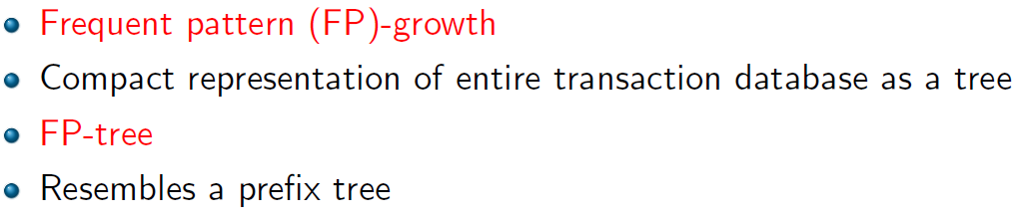
Frequent Pattern Tree
Jiawei Han, Jian Pei, and Yiwen Yin. 2000. Mining frequent patterns without candidate generation. In Proceedings of the 2000 ACM SIGMOD. [Citations: 9670]

Slide 22
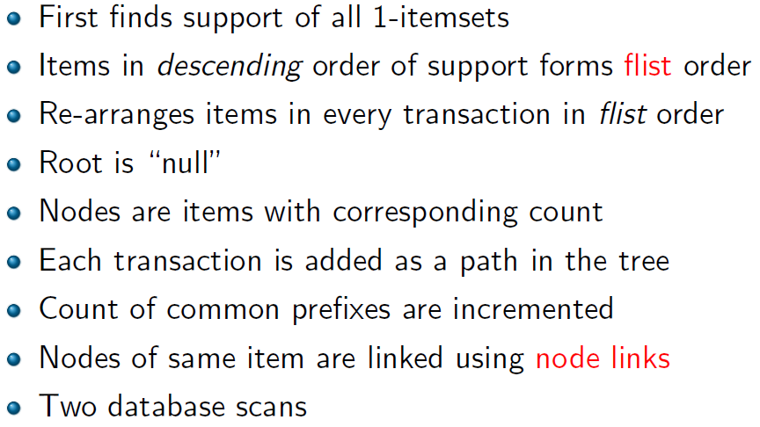
Algorithm

Slide 23
FP-Tree Construction
null
After reading TID=1:
A:1
B:1
After reading TID=2:
null
A:1
B:1
B:1
C:1
D:1

Slide 24

FP-Tree Construction
Transaction Database
null
A:7
B:3
B:5
C:3
C:1
D:1
Header table
D:1
C:3
E:1
D:1
E:1
D:1
E:1
D:1
Pointers are used to assist frequent itemset generation

Slide 25
FP-growth
To mine frequent itemsets containing E (starts with the least frequent item)
Identify paths containing E
Build conditional pattern base
Build conditional pattern base for E: P = {(A:1,C:1,D:1), (A:1,D:1), (B:1,C:1)}
Recursively apply FP-growth on P
null
A:7
B:3
B:5
C:3
C:1
D:1
C:3
D:1
D:1
E:1
D:1
E:1
E:1
D:1

Slide 26
FP-growth
Conditional tree for E:
Conditional Pattern base for E: P = {(A:1,C:1,D:1,E:1), (A:1,D:1,E:1), (B:1,C:1,E:1)}
Count for E is 3: {E} is frequent itemset
Recursively apply FP-growth on P
Assume minSup=2
null
A:2
C:1
C:1
D:1
D:1

Slide 27
FP-growth
Conditional tree for D within conditional tree for E:
Conditional pattern base for D within conditional base for E: P = {(A:1,C:1,D:1), (A:1,D:1)}
Count for D is 2: {D,E} is frequent itemset
Recursively apply FP-growth on P
null
A:2

Slide 28
FP-growth
Conditional tree for A within D within E:
Count for A is 2: {A,D,E} is frequent itemset
Next step:
This recursion stops
Construct conditional tree C within conditional tree E
Continue until exploring conditional tree for A (which has only node A)
null

Slide 29
FP-growth
Conditional tree for C within E:
Conditional Pattern base for CE: P = {(A:1,C:1,E:1), (C:1,E:1)}
Output 2:{C,E}
Return since no further recursion
Assume minSup=2
null

Slide 30
FP-growth
Conditional tree for A within conditional of E:
Conditional Pattern base for E: P = {(A:2, E:2)}
Output 2:{A,E}
No further recursion.
Assume minSup=2
null

Slide 31
Benefits of the FP-tree Structure
Performance study shows
FP-growth is an order of magnitude faster than Apriori
Reasoning
No candidate generation, no candidate test, only counting
Eliminates repeated database scans

Slide 32
More on association rule mining
Clearly the space of all association rules is exponential, O(2^{m}), where m is the number of items in I.
The mining exploits sparseness of data, and high minimum support and high minimum confidence values.
Still, it always produces a huge number of rules, thousands, tens of thousands, millions, ...
How can we reduce the number of rules?

Slide 33
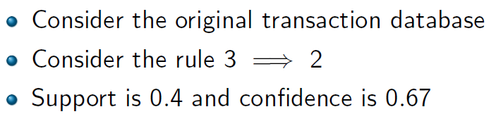
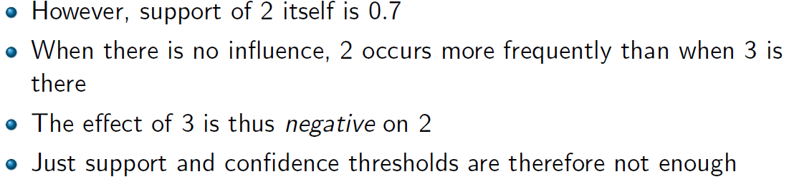
Are association rules always good?

Slide 34
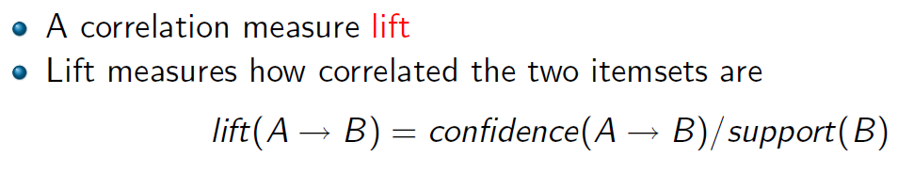
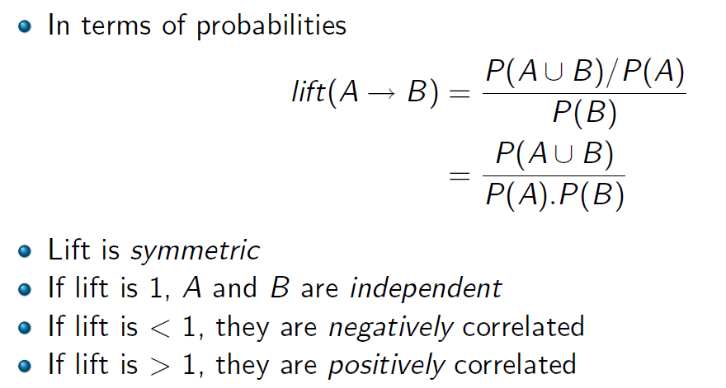

Lift

Slide 35
Problems with the association mining
Single minsup: It assumes that all items in the data are of the same nature and/or have similar frequencies.
Not true: In many applications, some items appear very frequently in the data, while others rarely appear.
E.g., in a supermarket, people buy TV and laptops much less frequently than they buy bread and milk.

Slide 36
Rare Item Problem
If the frequencies of items vary a great deal, we will encounter two problems
If minsup is set too high, those rules that involve rare items will not be found.
To find rules that involve both frequent and rare items, minsup has to be set very low. This may cause combinatorial explosion
At what rate does the number of frequent itemsets grow with support threshold?

Slide 37
Multiple minsups model
The minimum support of a rule is expressed in terms of minimum item supports (MIS) of the items that appear in the rule.
Each item can have a minimum item support.
By providing different MIS values for different items, the user effectively expresses different support requirements for different rules.

Slide 38
Minsup of a rule
Let MIS(i) be the MIS value of item i. The minsup of a rule R is the lowest MIS value of the items in the rule.
I.e., a rule R: a₁, a₂, …, a_{k} → a_{k+1}, …, a_{r} satisfies its minimum support if its actual support is ≥
min{MIS(a₁), MIS(a₂), …, MIS(a_{r})}.

Slide 39
An Example
Consider the following items:
bread, shoes, clothes
The user-specified MIS values are as follows:
MIS(bread) = 2% MIS(shoes) = 0.1%
MIS(clothes) = 0.2%
The following rule doesn’t satisfy its minsup:
clothes → bread [sup=0.15%,conf =70%]
The following rule satisfies its minsup:
clothes → shoes [sup=0.15%,conf =70%]

Slide 40
Apriori property: Does it hold?
In the new model, the property no longer holds (?)
E.g., Consider four items 1, 2, 3 and 4 in a database. Their minimum item supports are
MIS(1) = 10% MIS(2) = 20%
MIS(3) = 5% MIS(4) = 6%
{1, 2} with support 9% is infrequent, but {1, 2, 3} and {1, 2, 4} could be frequent.

Slide 41
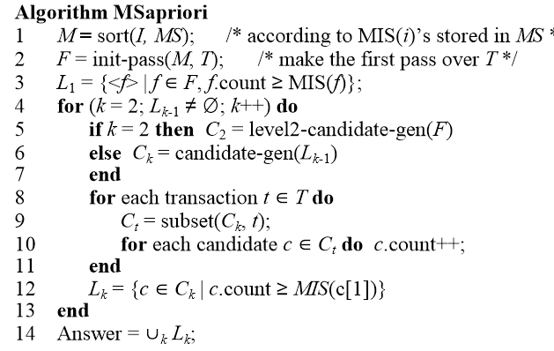
The MSapriori algorithm
Key areas that are different from Apriori algorithm

Slide 42

Step 1:Sort
We sort all items in I according to their MIS values (make it a total order).
The order is used throughout the algorithm in each itemset.
Each itemset w is of the following form:
{w[1], w[2], …, w[k]}, consisting of items,
w[1], w[2], …, w[k],
where MIS(w[1]) ≤ MIS(w[2]) ≤ … ≤ MIS(w[k]).

Slide 43
Step 2: Construct F
It makes a pass over the data to record the support count of each item.
It then follows the sorted order to find the first item i in M that meets MIS(i).
i is inserted into F.
For each subsequent item j in M after i, if j.count/n ≥ MIS(i) then j is also inserted into F, where j.count is the support count of j and n is the total number of transactions in T. Why?

Slide 44
Step 3: Construct L
Insert all items in L that have support higher than the specified minimum support

Slide 45
First pass over data: an example
Consider the four items 1, 2, 3 and 4 in a data set. Their minimum item supports are:
MIS(1) = 10% MIS(2) = 20%
MIS(3) = 5% MIS(4) = 6%
Assume our data set has 100 transactions. The first pass gives us the following support counts:
{3}.count = 6, {4}.count = 3,
{1}.count = 9, {2}.count = 25.
Then F = {3, 1, 2}, and L₁ = {{3}, {2}}
Item 4 is not in F because 4.count/n < MIS(3) (= 5%),
{1} is not in L₁ because 1.count/n < MIS(1) (= 10%).

Slide 46

Frequent itemsets
Which are the frequent 1-itemsets?
L₁ or F
To generate 2-itemsets, should we use L₁ or F?

Slide 47
On multiple minsup rule mining
Multiple minsup model subsumes the single support model.
It is a more realistic model for practical applications.
The model enables us to found rare item rules yet without producing a huge number of meaningless rules with frequent items.
By setting MIS values of some items to 100% (or more), we effectively instruct the algorithms not to generate rules only involving these items.

Slide 48
Sequential pattern mining
Association rule mining does not consider the order of transactions.
In many applications such orderings are significant. E.g.,
In market basket analysis, it is interesting to know whether people buy some items in sequence
In Web usage mining, it is useful to find navigational patterns of users in a Web site from sequences of page visits of users
In trajectory mining of holiday trips, it is useful to mine the sequence in which tourists visit the popular places.

Slide 49
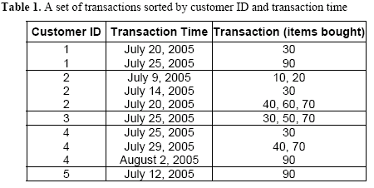
Example

Slide 50
Basic concepts
Let I = {i₁, i₂, …, i_{m}} be a set of items.
Sequence: An ordered list of itemsets.
We assume without loss of generality that items in an itemset of a sequence are in lexicographic order.

Slide 51
Basic concepts (contd)
Size: The size of a sequence is the number of itemsets in the sequence.
Length: The length of a sequence is the number of items in the sequence.
A sequence of length k is called k-sequence.
A sequence s₁ = ⟨a₁a₂…a_{r}⟩ is a subsequence of another sequence s₂ = ⟨b₁b₂…b_{v}⟩, or s₂ is a supersequence of s₁, if there exist integers 1 ≤ j₁ < j₂ < … < j_{r−1} < j_{r} ≤ v such that a₁ ⊆ b_{j1}, a₂ ⊆ b_{j2}, …, a_{r} ⊆ b_{jr}. We also say that s₂ contains s₁.

Slide 52
An example
Let I = {1, 2, 3, 4, 5, 6, 7, 8, 9}.
Is Sequence ⟨{3}{4, 5}{8}⟩ contained in (or is a subsequence of) ⟨{6} {3, 7}{9}{4, 5, 8}{3, 8}⟩ ?
Yes, because {3} ⊆ {3, 7}, {4, 5} ⊆ {4, 5, 8}, and {8} ⊆ {3, 8}.
Is ⟨{3}{8}⟩ contained in ⟨{3, 8}⟩ ?
No
The size of the sequence ⟨{3}{4, 5}{8}⟩ is ?
3
the length of the sequence is ?
4.

Slide 53
Objective
Given a set S of input data sequences (or sequence database), the problem of mining sequential patterns is to find all the sequences that have a user-specified minimum support.
Each such sequence is called a frequent sequence, or a sequential pattern.
The support for a sequence is the fraction of total data sequences in S that contains this sequence.

Slide 54
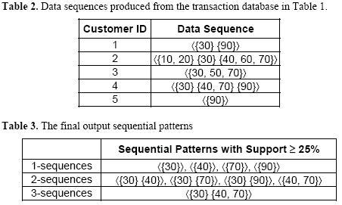
Example (cond)

Slide 55
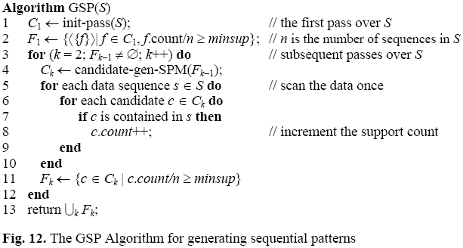
GSP mining algorithm
Very similar to the Apriori algorithm
Mining sequential patterns. R Agrawal, R Srikant . ICDE, 1995. Cited by 5403

Slide 56
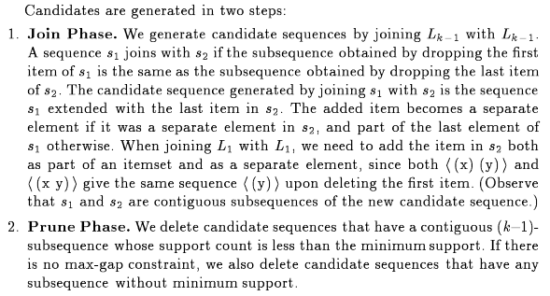
Candidate generation

Slide 57
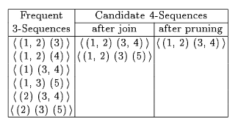
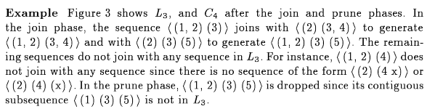
An example

Slide 58
First tasks for project
Read the initial paper well
Find out all related and follow-up works
Learn to use google scholar
Easiest way to get a decent grade
Identify the state-of-the-art algorithm for the proposed problem
Implement the algorithm
You are not allowed to submit the authors’ code
You can use libraries like PyTorch, Tensorflow, etc.

Slide 59
PrefixSpan-1
Step 1. Find length-1 sequential patterns
→Scan DB once to find all frequent items in sequences
Step 2. Divide search space
→Partitioned into the following subsets according to the prefixes
Step 3. Find subsets of sequential patterns
→The subsets of sequential patterns can be mined by constructing corresponding projected databases and mine each recursively
PrefixSpan: Mining Sequential Patterns Efficiently by Prefix-Projected Pattern Growth. Jian Pei , Jiawei Han , Behzad Mortazavi-asl , Helen Pinto , Qiming Chen , Umeshwar Dayal , Mei-chun Hsu, In Proceedings of the 17th International Conference on Data Engineering (ICDE '01). [Citations: 3169]

Slide 60
PrefixSpan-1 (Example)
Sequence_id | Sequence
10 | < a ( abc ) ( ac ) d ( cf ) >
20 | < ( ad ) c ( bc ) ( ae ) >
30 | < ( ef ) ( ab ) ( df ) cb >
40 | < eg ( af ) cbc >
min_support = 2
L1：<a> : 4，<b> : 4 ，<c> : 4
<d> : 3，<e> : 3，<f> : 3

Slide 61
PrefixSpan-1 (Example) (Cont.)
10 | <a(abc)(ac)d(cf)>
20 | <(ad)c(bc)(ae)>
30 | <(ef)(ab)(df)cb>
40 | <eg(af)cbc>
L1：<a> : 4，<b> : 4 ，<c> : 4
<d> : 3，<e> : 3，<f> : 3
Prefix | Projected (Postfix) Database
< a > | <(abc)(ac)d(cf)> , <(_d)c(bc)(ae)> <(_b)(df)cb> , <(_f)cbc>
< b > | <(_c)(ac)d(cf)> , <(_c)(ae)> , <(df)cb> , <c>
< c > | <(ac)d(cf)> , <(bc)(ae)> , <b> , <bc>
< d > | <(cf)> , <c(bc)(ae)> , <(_f)cb>
< e > | <(_f)(ab)(df)cb> , <(af)cbc>
< f > | <(ab)(df)cb> , <cbc>

Slide 62
PrefixSpan-1 (Example) (Cont.)
< a > | <(abc)(ac)d(cf)> , <(_d)c(bc)(ae)> <(_b)(df)cb> , <(_f)cbc>
Scanning <a>-Projected database once:
a:2 , b:4 , c:4 , d:2 , e:1 , f:2
(_b):2 , (_c):1 , (_d):1 , (_e):1, (_f):1
→L2: <aa>:2 , <ab>:4 , <(ab)>:2
<ac>:4 , <ad>:2 , <af>:2

Slide 63
PrefixSpan-1 (Example) (Cont.)
Prefix | Projected (Postfix) Database
< aa > | <(_bc)(ac)d(cf)>
< ab > | <(_c)(ac)d(cf)> , <(_c)a> , <c>
< (ab) > | <(_c)(ac)d(cf)> , <(df)cb>
< ac > | <(ac)d(cf)> , <(bc)a> , <b> , <bc>
< ad > | <(cf)> , <(_f)cb>
< af > | <cb>

Slide 64
PrefixSpan-1 (Example) (Cont.)
< ab > | <(_c)(ac)d(cf)> , <(_c)a> , <c>
Scanning <ab>-Projected database once:
a:2 , c:2 , d:1 , f:1 , (_c):2
→L3: <a(bc)>:2 , <aba>:2 , <abc>:2

Slide 65
PrefixSpan-1 (Example) (Cont.)
Prefix | Projected (Postfix) Database
< a(bc) > | <(ac)(c)> , <a>
< aba > | <(_c)(c)>
< abc > | <(c)>
Scanning <a(bc)>-Projected database once:
a:2 , c:1
→L4: <a(bc)a>:2

Slide 66
PrefixSpan-1 (Example) (Cont.)
Prefix | Sequential Patterns
< a > | <a>, <aa>, <ab>, <a(bc)>, <a(bc)a>, <aba>, <abc>, <(ab)>, <(ab)c>, <(ab)d>, <(ab)f>, <(ab)dc>, <ac>, <aca>, <acb>, <acc>, <ad>, <adc>, <af>
< b > | <b>, <ba>, <bc>, <(bc)>, <(bc)a>, <bd>, <bdc>, <bf>
< c > | <c>, <ca>, <cb>, <cc>
< d > | <d>, <db>, <dc>, <dcb>
< e > | <e>, <ea>, <eab>, <eac>, <eacb>, <eb>, <ebc>, <ec>, <ecb>, <ef>, <efb>, <efc>, <efcb>
< f > | <f>, <fb>, <fbc>, <fc>, <fcb>

Slide 67
Completeness of PrefixSpan-1
SDB
SID
sequence
10
<a(abc)(ac)d(cf)>
Length-1 sequential patterns
<a>, <b>, <c>, <d>, <e>, <f>
20
<(ad)c(bc)(ae)>
30
<(ef)(ab)(df)cb>
40
<eg(af)cbc>
Having prefix <c>, …, <f>
Having prefix <a>
Having prefix <b>
<a>-projected database
<(abc)(ac)d(cf)>
<(_d)c(bc)(ae)>
<(_b)(df)cb>
<(_f)cbc>
Length-2 sequential
patterns
<aa>, <ab>, <(ab)>,
<ac>, <ad>, <af>
<b>-projected database
…
… …
Having prefix <aa>
Having prefix <af>
<aa>-proj. db
…
<af>-proj. db

Slide 68
Analysis
No candidate sequence needs to be generated by PrefixSpan
Projected databases keep shrinking
The major cost of PrefixSpan is the construction of projected databases
Does not look into repeated occurrence within same sequence
B. Ding, D. Lo, J. Han, and S.-C. Khoo. Efficient mining of closed repetitive gapped subsequences from a sequence database. In Data Engineering, 2009. ICDE

Slide 69
Closed Patterns and Maximal Patterns
Solution: Mine closed patterns and maximal patterns instead
An itemset X is closed if X is frequent and there exists no super-pattern Y כ X, with the same support as X (proposed by Pasquier, et al. @ ICDT’99)
An itemset X is a maximal if X is frequent and there exists no frequent super-pattern Y כ X (proposed by Bayardo @ SIGMOD’98)

Slide 70
Example
minSup=40%
I1={2,3,4} Support 50%
I2={2,3,4,1} Support 50%
I3={3,4,1} Support 60%
Which of these itemsets are closed?
Which of these itemsets are maximal?
Do we loose any information if we only store closed patterns?
Do we loose any information if we only store maximal patterns?

